Slide 1
Text data
Topic Modeling, NLP and other treatments to text
Hugo Barroso Barreto Marcelo B. Barata Ribeiro

Slide 2
Summary
Definitions
Text Data Pre-Processing
Topic Modelling
Context/Word Prediction
Word Embedding
Computer Vision and OCR
Information Retrival

Slide 3
Definitions

Slide 4
Definitions
Word – A delimited string of characters as it appears in the text.
Term – A “normalized” word (case, morphology, spelling etc.); an equivalence class of words.
Token – An instance of a word or term occurring in a document.
Type – The same as a term in most cases: an equivalence class of tokens.
Corpus – A collection of documents
Notes:
Análise exploratória de dados para identificar padrões.
O que é expressão regular: é uma representação de padrões em um corpo de texto, que permite localizar ou modificar caracteres ou palavras específicas de forma mais dinâmica.

Slide 5
Text Data Pre-Processing

Slide 6
Stopwords Removal
Stopwords: extremely common words which would appear
to be of little value in differentiating documents topics.
Examples: a, an, and, are, as, at, be, by, for, from, has, he, in,
is, it, its, of, on, that, the, to, was, were, will, with

Slide 7
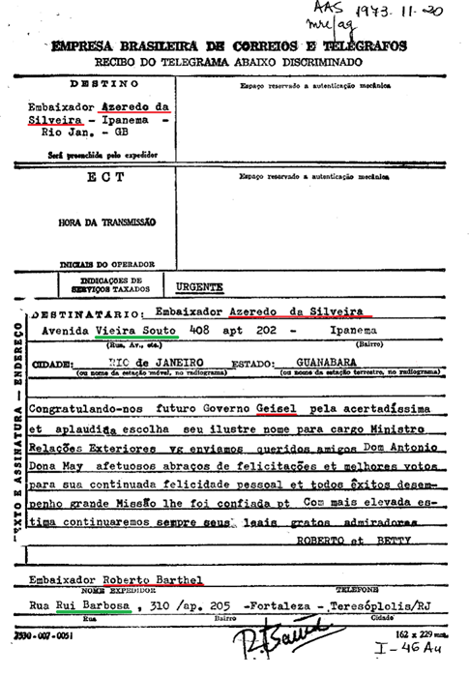
Named-entity recognition
Named-entity recognition (NER) aims to find named entities in text and classify them into predefined categories (names of persons, locations, organizations, times, etc.).
Ferramentas:
palavras
Stanford NLP
Notes:
Palavras é uma ferramenta de PLN (NLP) criada por Eckhard Bick.
Haveria muita perda de informação ao usar a alternativa de traduzir, pois já há perda na fase de OCR.
Mencionar os nomes duplicados e a necessidade de fazer análise exploratória para analisar os nomes.
Falar de entidade ativa e entidade passiva.
Mostrar o dataframe no código. Falar sobre a maior tolerância a Falsos Positivos para nomes de alta relevância.

Slide 8
Normalization
Normalizing text means converting it to a more convenient, standard form. We most commonly implicitly define equivalence classes of terms and tokenizing them.
Regular Expressions
Lemmatization
Stemming
Tokenization

Slide 9
Lemmatization
Lemmatization is the process of grouping together the inflected forms of a word to dictionary form (the lemma).
Depends on correctly identifying the intended part of speech and meaning of a word in a sentence.
Notes:
https://www.datacamp.com/community/tutorials/stemming-lemmatization-python
https://towardsdatascience.com/stemming-lemmatization-what-ba782b7c0bd8
university, universal, universities, and universe.
Lemma: morphological analysis. This allows it to do better resolutions (like resolving is and are to “be”)

Slide 10
Stemming
Definition: Crude heuristic process that chops off the ends of words reducing to their word stem, base or root form in the hope of achieving what “principled” lemmatization attempts to do with a lot of linguistic knowledge.
Related words map to the same stem
Porter Stemmer is the most common algorithm for stemming English
Stemmer operates on a single word without knowledge of the context (faster and easier to implement compared to lemmatization)

Slide 11
Pre-Processing Dilemma
There is always a trade-off between noise reduction and loss of information.
Case folding - Reduce all letters to lower case
MIT vs. mit
Fed vs. fed
Stemmer equivalence class oper contains all of operate
operating operates operation operative operatives operational.

Slide 12
Tokenization Difficulties
One word or two? (or several)
Hewlett-Packard
State-of-the-art
Los Angeles-based company
Numbers
3/20/91 vs. 20/3/91
(800) 234-2333
Compounded words (“No whitespace” words)
Accents and diacritics

Slide 13
Topic Modelling

Slide 14
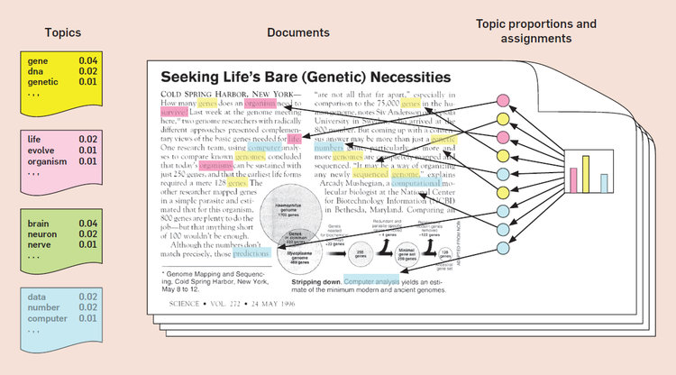
Topic Modelling

Slide 15
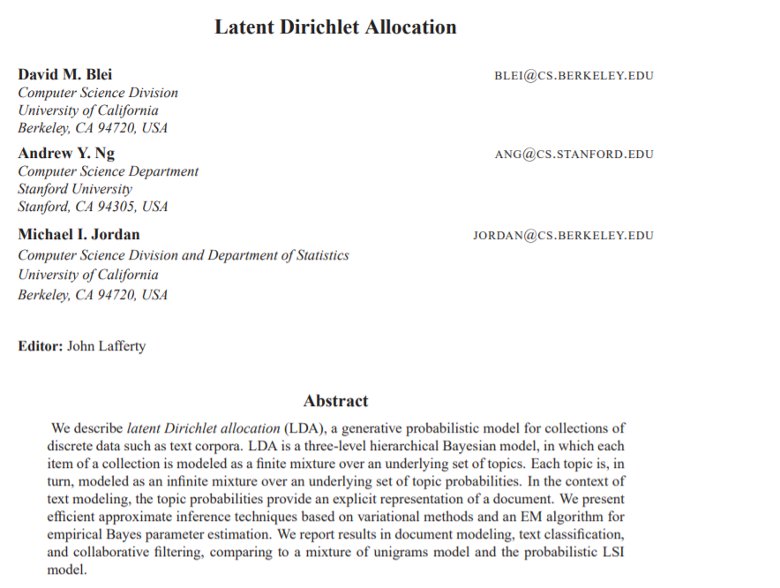
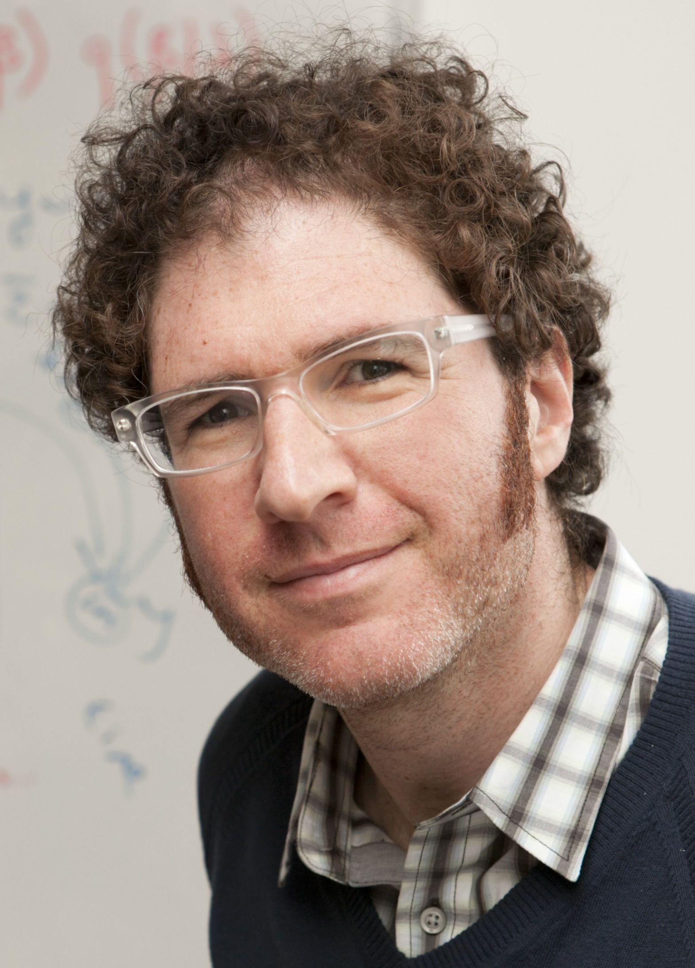
Latent Dirichlet Allocation

Slide 16
LDA assumptions
The order of the words in the document does not matter (“bag of words” assumption)
The order of documents does not matter
The number of topics is assumed known and fixed

Slide 17
Latent Dirichlet Allocation
1. Randomly choose a distribution over topics.
2. For each word in the document
(a) Randomly choose a topic from the distribution over topics in step #1.
(b) Randomly choose a word from the corresponding distribution over the vocabulary.
All the documents in the collection share the same set of topics, but each document exhibits those topics with different proportion.

Slide 18
Latent Dirichlet Allocation
The documents themselves are observed, while the topic structure (the topics, per-document topic distributions, and the per-document per-word topic assignments) are hidden structure.
We are reversing “the generative process”: what is the hidden structure that likely generated the observed collection?

Slide 19
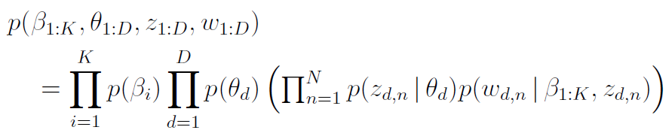
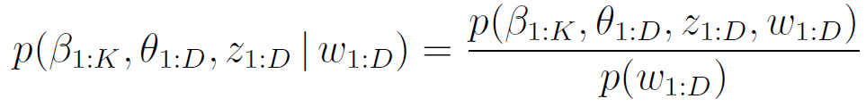
Latent Dirichlet Allocation
The generative process for LDA corresponds to the following joint distribution of the hidden and observed variables:
Variables: topic assignment, per-document topic proportions, observed words and topics.
Posterior distribution

Slide 20
Topic Modelling
Python packages: gensim, sklearn and pyLDAvis
Mostly used model: LDA (Latent Dirichlet Allocation)
Alternatives:
HDP (Hierarchical Dirichlet Process)
LSI (Latent Semantic Index)
Notes:
No processamento de linguagem natural, o LDA é um modelo estatístico que permite categorizar observações ou dados em grupos/clusters de acordo com seu grau de similaridade. Cabe ao especialista analisar os grupos construídos por esse método de modo a identificar seu respectivo tema.
Modelo desenvolvido por David Blei em 2003, com colaboração de outros autores, tal como: Andrew Ng.
O número de tópicos afeta o resultado: poucos tópicos implicam em tópicos muito genéricos. Muitos tópicos implicam em tópicos mais detalhados, no entanto, isso aumenta tópicos duplicados.
Deixar exemplo aberto no chrome.

Slide 21
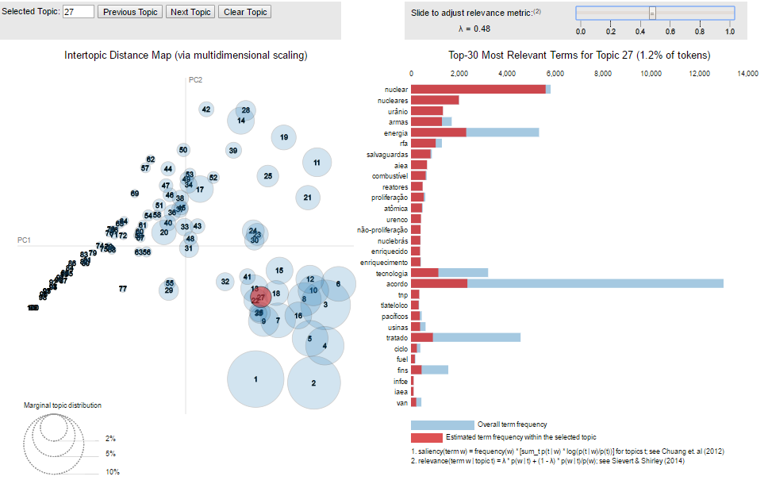

Slide 22
Validation
The generated topics demand the collaboration of domain experts for validation and naming.
It usually comprehends exhaustive analysis of topics, tokens and documents, and also formulation of cohesion index
It is possible to partly automate this process. See, for example, the paper “Exploring the Space of Topic Coherence Measures”
Notes:
Topic coherence measures: Umass and UCI.

Slide 23
Context/Word Prediction

Slide 24
n-grams
n-gram is a contiguous sequence of n items from a given sample of text or speech.
Data science is fun
Unigrams: look at individual words. “data”, “science”, “is”, “fun”
Bigrams: look at word pairs. “data science”, “science is”, “is fun”
Trigrams: look at word triplets. “data science is”, “science is fun”

Slide 25
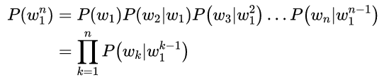
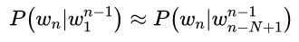
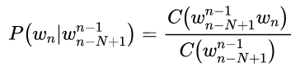
n-grams models
n-grams models are Markov models that estimate words from a fixed window of previous words.
n-gram probabilities can be estimated by counting in a corpus and normalizing (the maximum likelihood estimate)

Slide 26
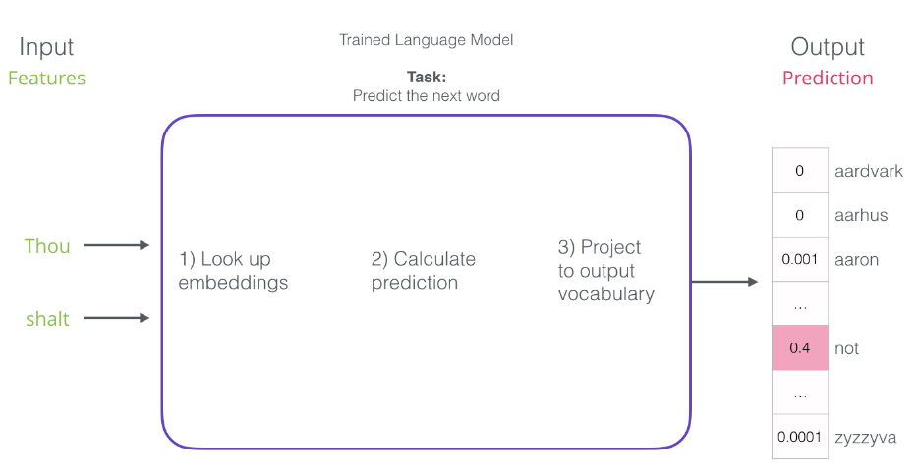
Early Neural Models

Slide 27
Word Embedding

Slide 28
Vector Semantics
The idea of vector semantics is thus to represent a word as a point in some multidimensional semantic space.
Vectors for representing words are called embeddings, because the word is embedded in a particular vector space.
tf-idf
Word2Vec
GloVe
Word and document similarities are computed by some function of the dot product between vectors. The cosine of two vectors is the most popular such metric.

Slide 29
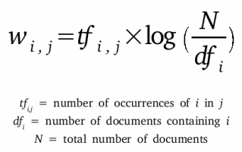
TF-IDF
The main idea is to weight co-occurrence matrix (|V|x|V|) by each term tf-idf value calculated over a corpus.
Baseline model for word embedding.
Generates a sparse space.

Slide 30
Word2Vec
The intuition of word2vec is train a classifier on a binary prediction task: “Is word w likely to show up near apricot?”, ignore the result and instead take the learned classifier weights as the word embeddings.
Generates a Smaller (50-1000 dimensions) and Dense (most values are non-zero) space.
Smaller and dense vectors are good for saving computation resources and avoid overfitting.
Main Algorithms:
Continuous Bag of Words: “predict” word from context
Skipgram (with Negative Sampling): “predict” context from word

Slide 31
Word2Vec - SGNS
The intuition of skip-gram is:
1. Treat the target word and a neighboring context word as positive examples.
2. Randomly sample other words in the lexicon to get negative samples.
3. Use logistic regression to train a classifier to distinguish those two cases.
4. Use the regression weights as the embeddings.
Two key hyperparameters:
window size
number of negative samples.

Slide 32
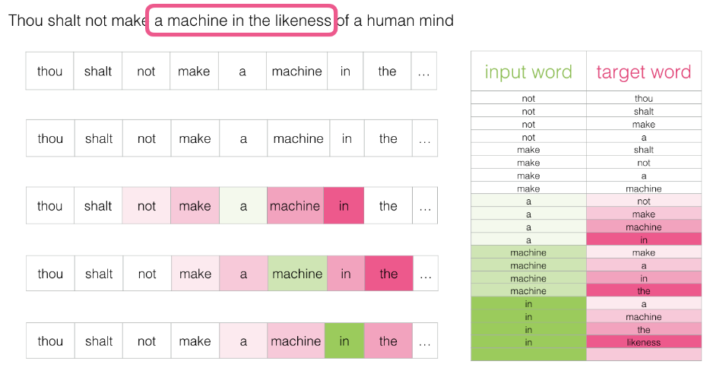
Word2Vec - SGNS

Slide 33
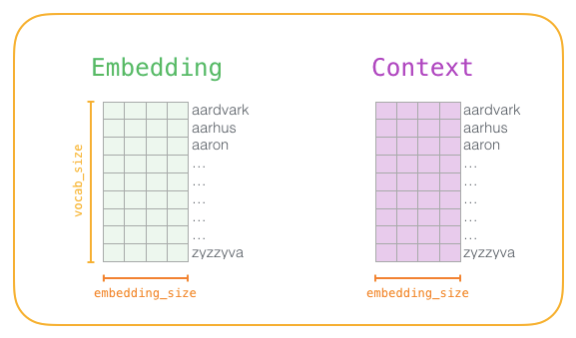
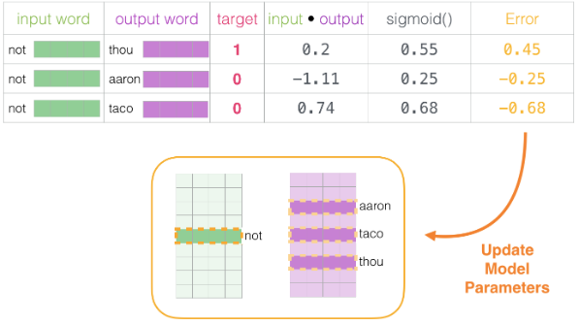
Word2Vec - SGNS

Slide 34
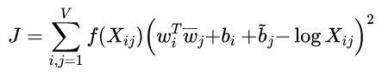
GloVe
GloVe - Global Vectors -does not rely just on local statistics (local context information of words), but incorporates global statistics (word co-occurrence).
The main intuition underlying the model is that ratios of word-word co-occurrence probabilities have the potential for encoding some form of meaning.

Slide 35
Computer vision and OCR

Slide 36
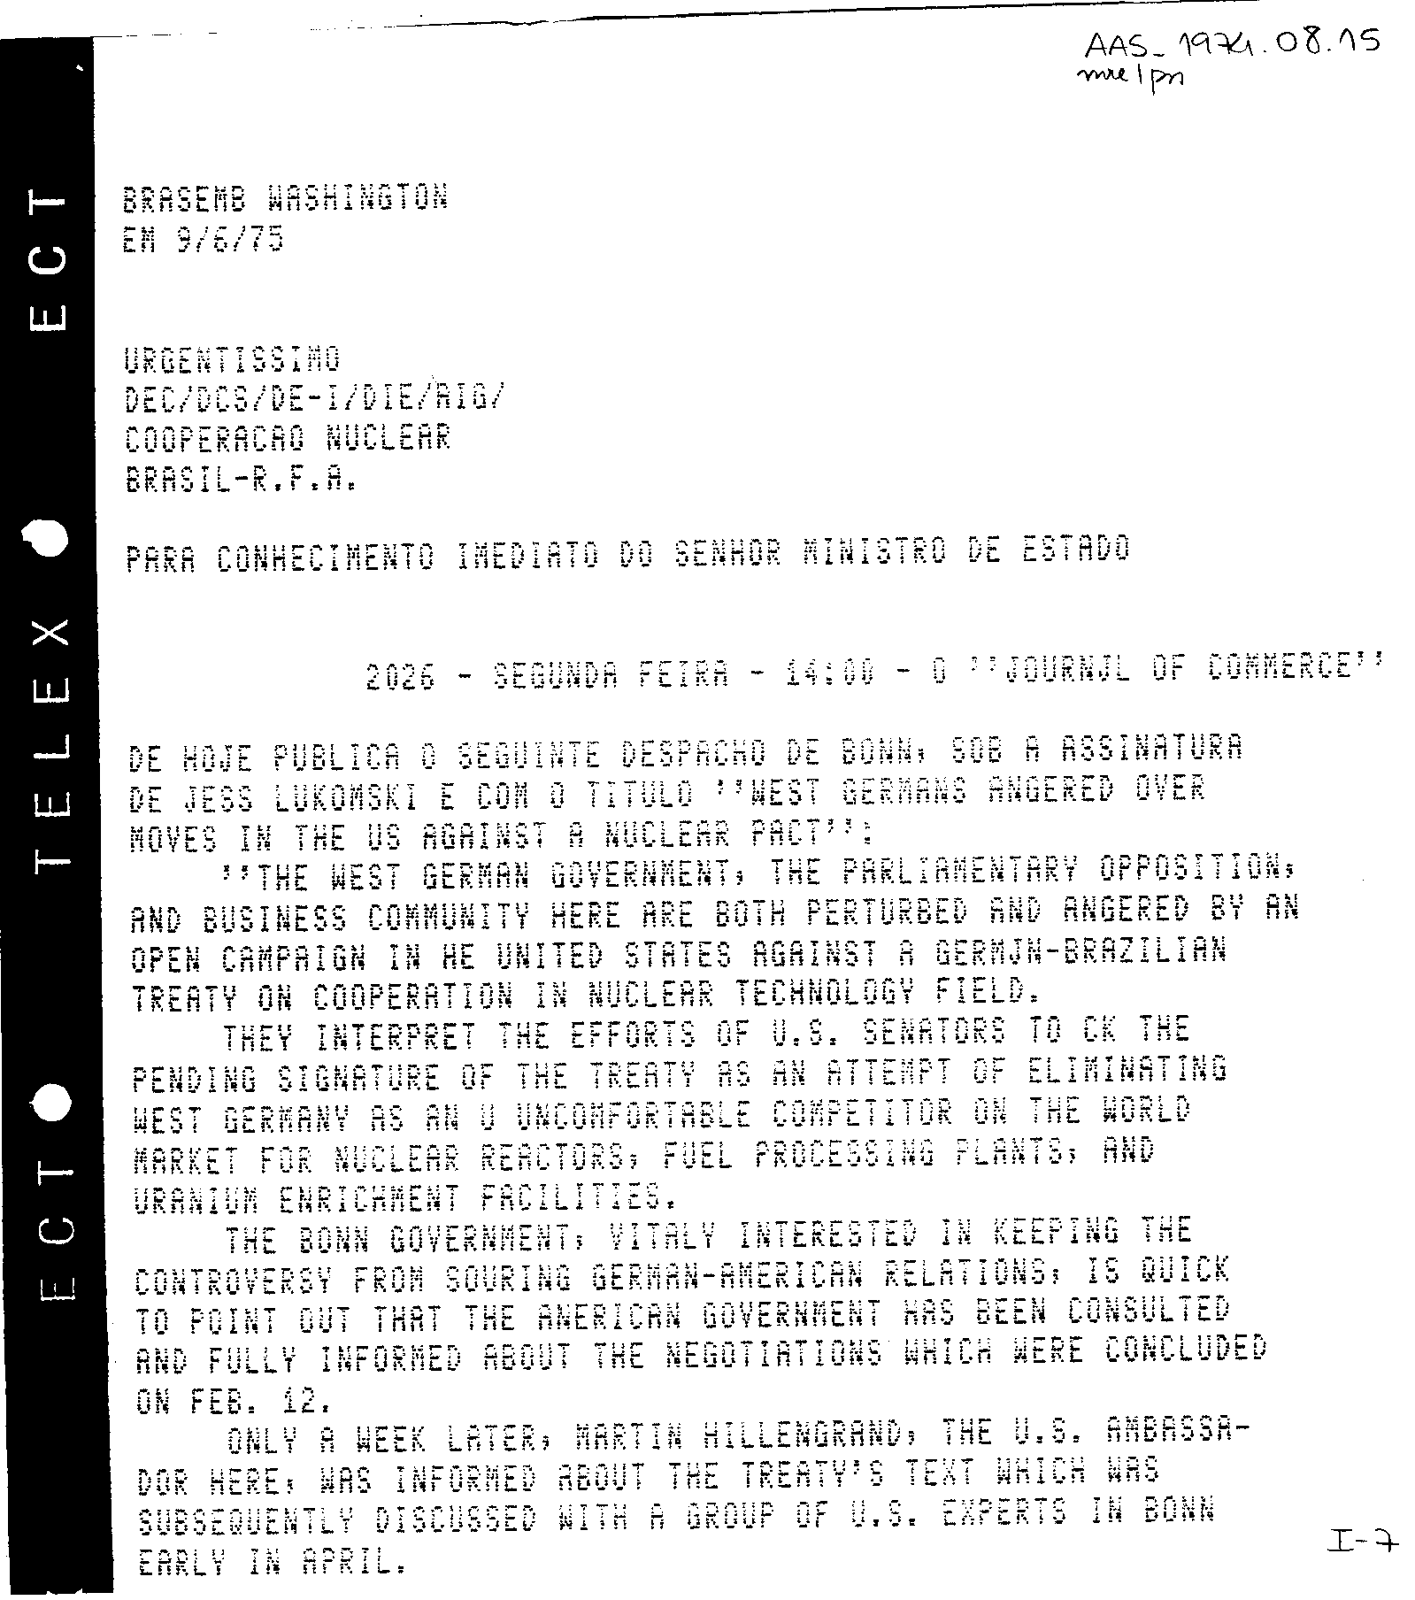

Slide 37
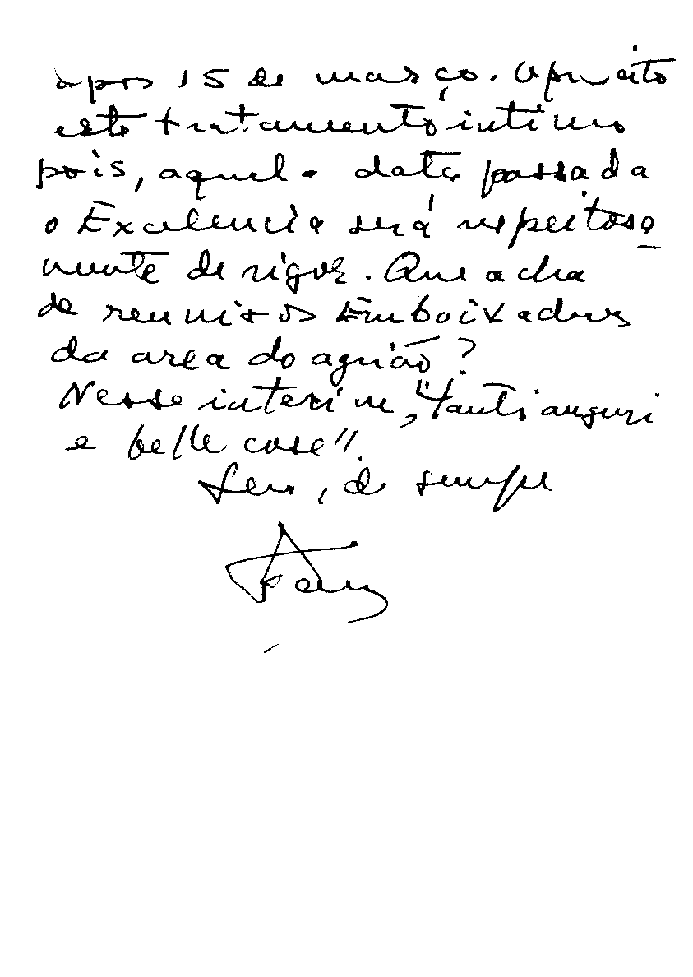
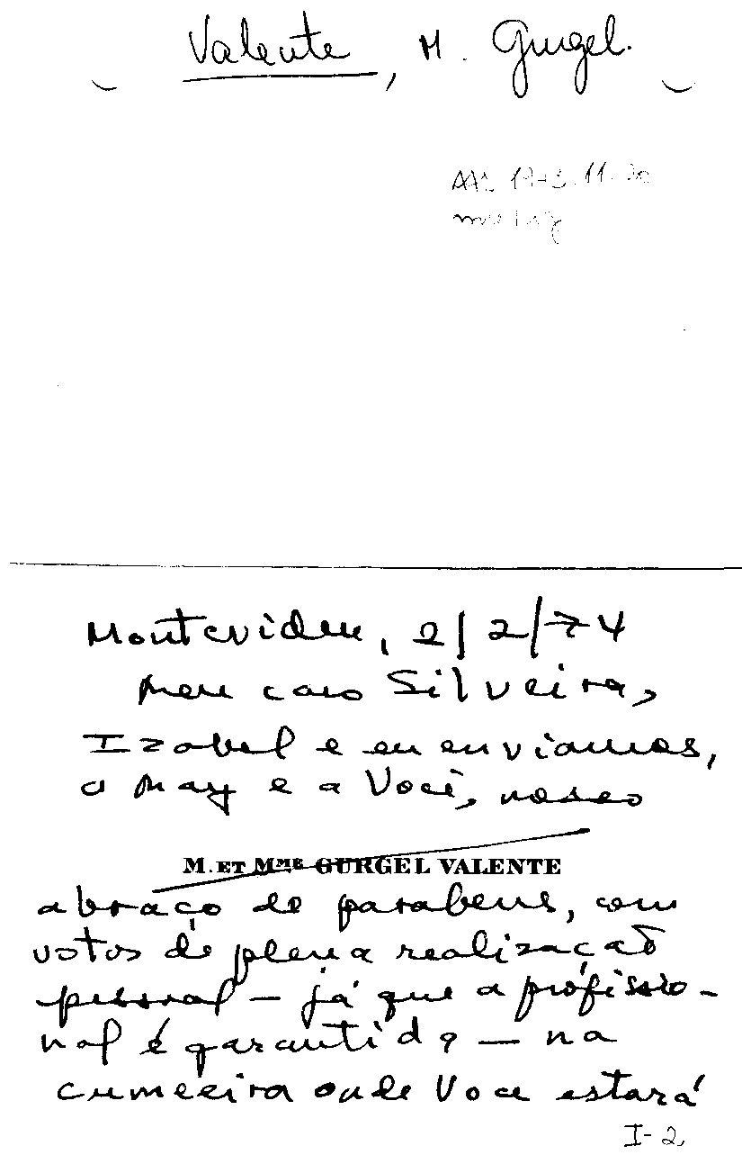

Slide 38
Computer vision e OCR
Ferramentas para lidar com imagens de texto:
Tesseract
Cloud Vision API
Transkribus (somente para manuscritos)

Slide 39
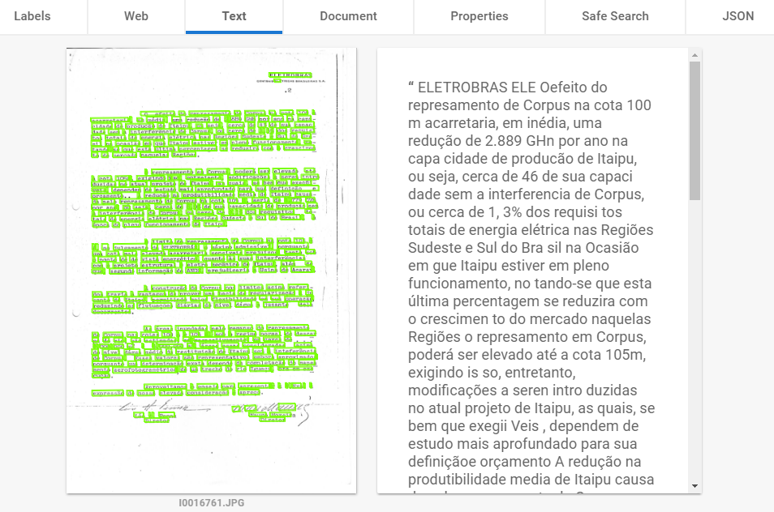

Slide 40
Information Retrival

Slide 41
Information Retrival
Information retrieval (IR) is finding material (usually documents) of an unstructured nature (usually text) that satisfies an information need from within large collections (usually stored on computers).
Model Types:
Set-theoretic models (Boolean Indexing)
Vector models (tf-idf, LSI)
Probabilistic models (LDA)

Slide 42
References

Slide 43
JURAFSKY D., MARTIH J. H. - Speech and Language Processing (3rd ed. draft) - August 29, 2019. http://web.stanford.edu/~jurafsky/slp3/
BLEI, David et al. - Latent Dirichlet Allocation
BLEI, David - Probabilistic Topic Models
The Illustrated Word2vec https://jalammar.github.io/illustrated-word2vec/
Text Preprocessing in Python: Steps, Tools, and Examples https://medium.com/@datamonsters/text-preprocessing-in-python-steps-tools-and-examples-bf025f872908
Curso IRI Lectures https://github.com/fccoelho/curso -IRI
Jeffrey Pennington, Richard Socher, and Christopher D. Manning. 2014. GloVe: Global Vectors for Word Representation. https://nlp.stanford.edu/projects/glove/
The Illustrated BERT, ELMo, and co. (How NLP Cracked Transfer Learning) https://jalammar.github.io/illustrated-bert/

Slide 44
BENGIO Y. et al. A Neural Probabilistic Language Model, 2003

Slide 45
Hugo Barroso Barreto
hugobarreto94@gmail.com
•
Marcelo Barata Ribeiro marcelobbribeiro@gmail.com

